Slide 1
Multielectron quantum dots in silicon for spin quantum computation
1
Andre Saraiva
IEEE Nano, Gijón, España, 2024

Slide 2
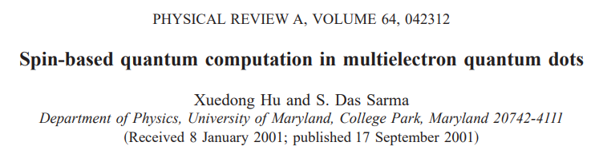
23 years ago multielectron qubits were proposed
“At first sight this idea of a single electron in a dot may seem far fetched because an array of semiconductor QDs, even under the most advanced growth and nanofabrication constraints, is likely to have more than a single electron on each dot”
“The single electron spin per quantum for idea is therefore based on the close-shell principle, where what is required is just one “valence” electron per quantum dot in the outermost “open” shell. The underlying idea here is that the closed-shell electrons (equivalent to the core electrons in atoms) are “inert” and could be ignored as far as qubit dynamics goes, and the unoccupied states are energetically too unfavourable to be involved as well.”

Slide 3
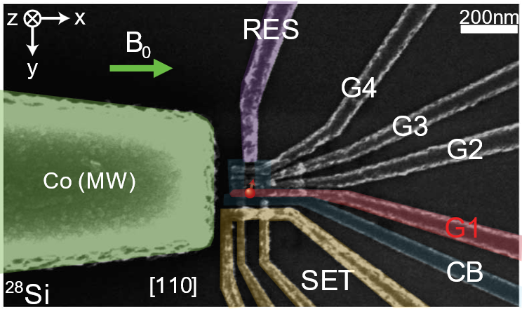
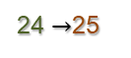
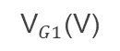
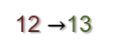
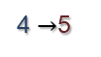
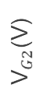
4 years ago: Honeymoon phase
31 electrons
$${\text{V}}_{G2}\text{(}\text{V}\text{)}$$
N=0
1 electron
4
12
24
$${\text{V}}_{G1}\text{(}\text{V}\text{)}$$
s
p
d
f
4 $→$5
Addition energy
(meV)
12 $→$13
24 $→$25
Electron number, N
R.C.C. Leon et al., Nature Communications 7, 797 (2020)

Slide 4
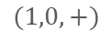
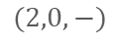
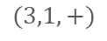
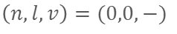
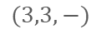
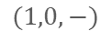
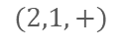
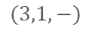
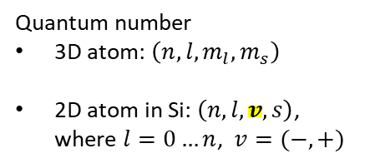
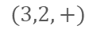
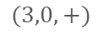
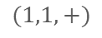
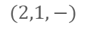
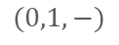
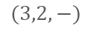
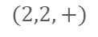
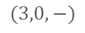
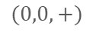
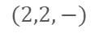


2D Fock-Darwin states
$$(3,0,+)$$
$$(3,1,+)$$
$$(3,2,+)$$
$$(3,3,+)$$
$$(3,0,−)$$
$$(3,1,−)$$
$$(3,2,−)$$
$$(3,3,−)$$
25
$$(2,0,+)$$
$$(2,1,+)$$
$$(2,2,+)$$
$$(2,0,−)$$
$$(2,1,−)$$
$$(2,2,−)$$
13
$$(1,0,+)$$
$$(1,1,+)$$
N=24
$$(1,0,−)$$
$$(0,1,−)$$
Quantum number
3D atom: $\left(n, l,m_{l},m_{s}\right)$
2D atom in Si: $\left(n, l,v,s\right)$, where $l=0…n$, $v=(−,+)$
5
N=12
$$(0,0,+)$$
N=4
$$\left(n,l,v\right)=(0,0,−)$$
1

Slide 5

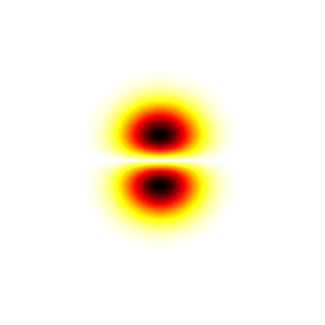
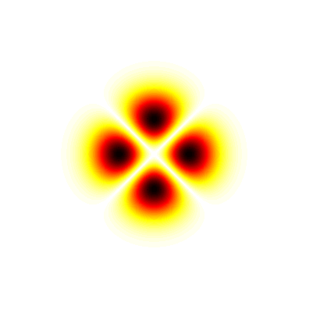
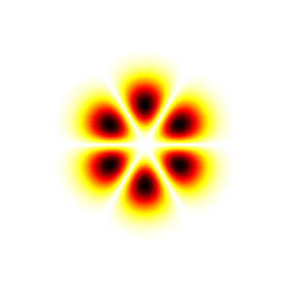
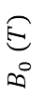
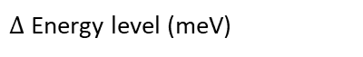
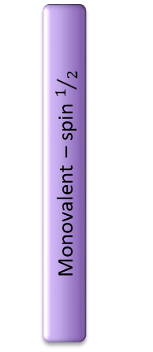
Magnetospectroscopy
1
2
3
4
Valley + spin quasidegeneracy
5
6
7
8
9
10
11
12
Monovalent – spin $1/2$
$$B_{0} (T)$$
13
14
15
16
17
18
19
20
21
22
23
24
5
Hund’s rule
S
25
26
27
28
29
30
31
0
0
0.5
$∆$ Energy level (meV)
Electron number, N
R.C.C. Leon et al., Nature Communications 7, 797 (2020)

Slide 6
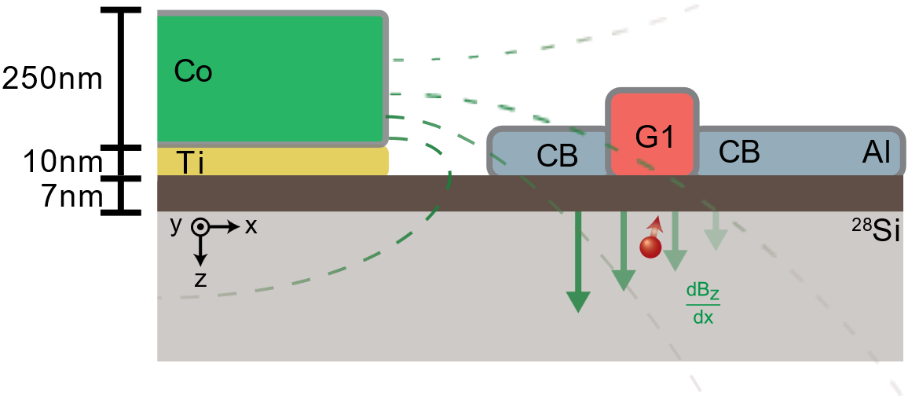
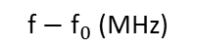
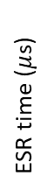
Coherent Spin Control using EDSR
B₀ = 1.4T
SiO₂
1 electron (s)
5 electrons (p)
13 electrons (d)
ESR time ($μ$s)
$$\text{f}−{\text{f}}_{0} \text{(}\text{MHz}\text{)}$$
$$\text{f}−{\text{f}}_{0} \text{(}\text{MHz}\text{)}$$
$$\text{f}−{\text{f}}_{0} \text{(}\text{MHz}\text{)}$$
R.C.C. Leon et al., Nature Communications 7, 797 (2020)

Slide 7
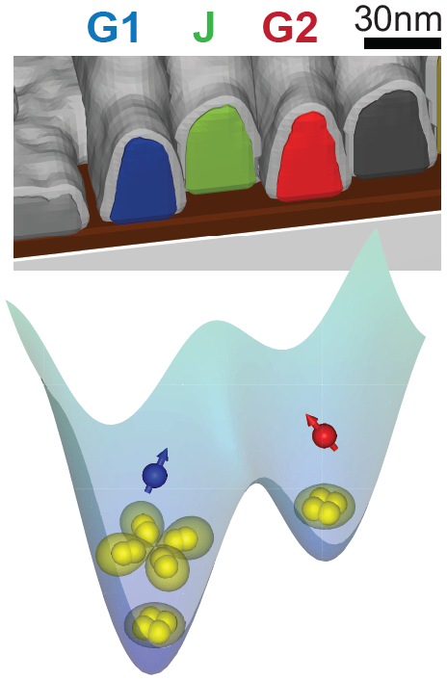
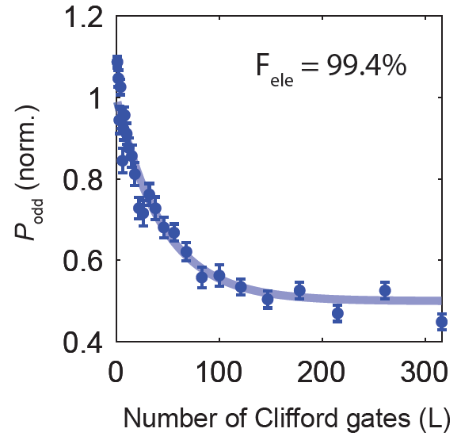
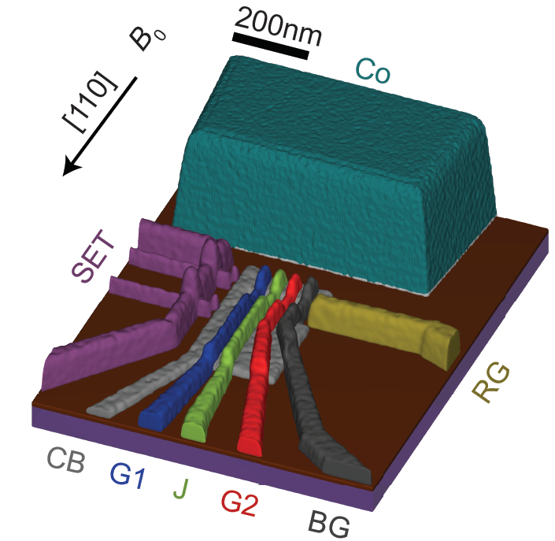
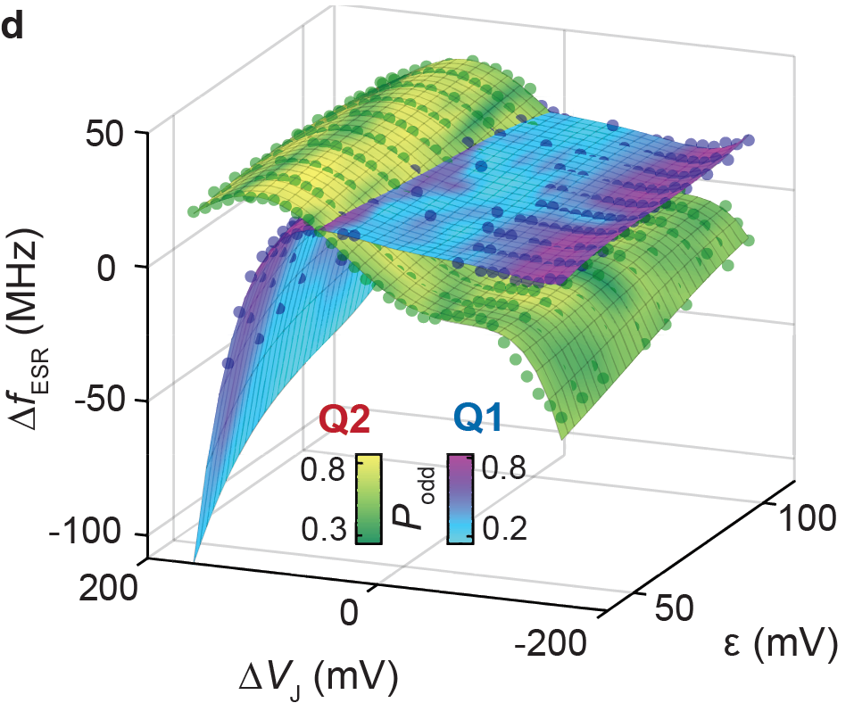
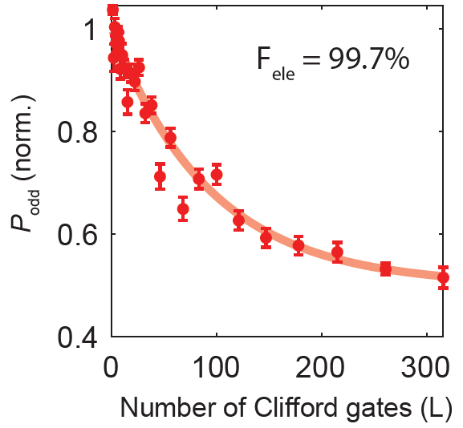
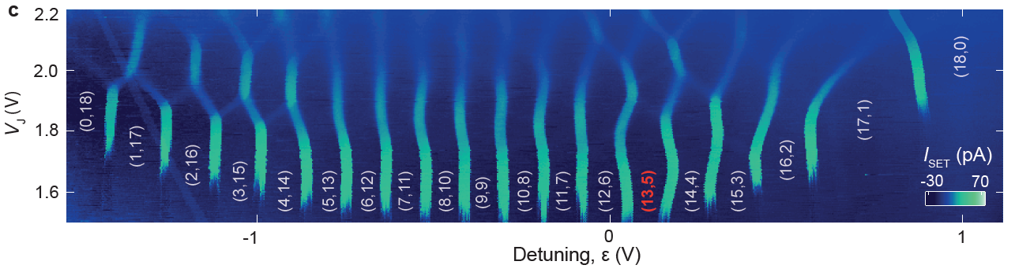
Isolated mode - (13,5) double quantum dot
a
b
d
Extended wavefunctions enable exchange coupling between dots very far apart
Q1
d-shell
p-shell
Q2
13 electrons under G1 (d-shell)
5 electrons under G2 (p-shell)
R.C.C. Leon et al., Nature Communications 12, 3228 (2021)
Notes:
Fig a: We continue using the same device (top left, fig a), which consists of Al gates, except the Co micromagnet for EDSR control. The quantum dots are laterally confined using CB and BG, with electrons supplied from a 2DEG under RG. And the SET on the side is for charge sensing.
For scalability purpose, the quantum dots are isolated from the electron reservoir, and electrons are accumulated under G1 and G2 (fig b).
we accumulate 18 electrons in total between the two quantum dots, and in the charge stability diagram at the bottom (fig c), if we detune the potential well between the 2 dots, electron tunnels between them one by one, resulting in these vertical lines here.
From our previous studies, we know that when there are 5 and 13 electrons in a Si quantum dot we have one single electron in the outermost shell, which are p- and d-shells respectively (fig b). Each of them effectively forms a spin-1/2 system.
The extended wavefunction of multielectron quantum dots not only screens the interface disorder at the atomic level, but also allows us to place a reasonably large Al gate between the quantum dots, directly control the exchange coupling between them.
The figure over here (fig d) shows the ESR frequency of both qubits as a function of gate detuning and J-gate voltage, with colour bar indicating qubit performance. We use this map to find their optimal single qubit operation point, with control fidelity over 99% for both qubits.

Slide 8
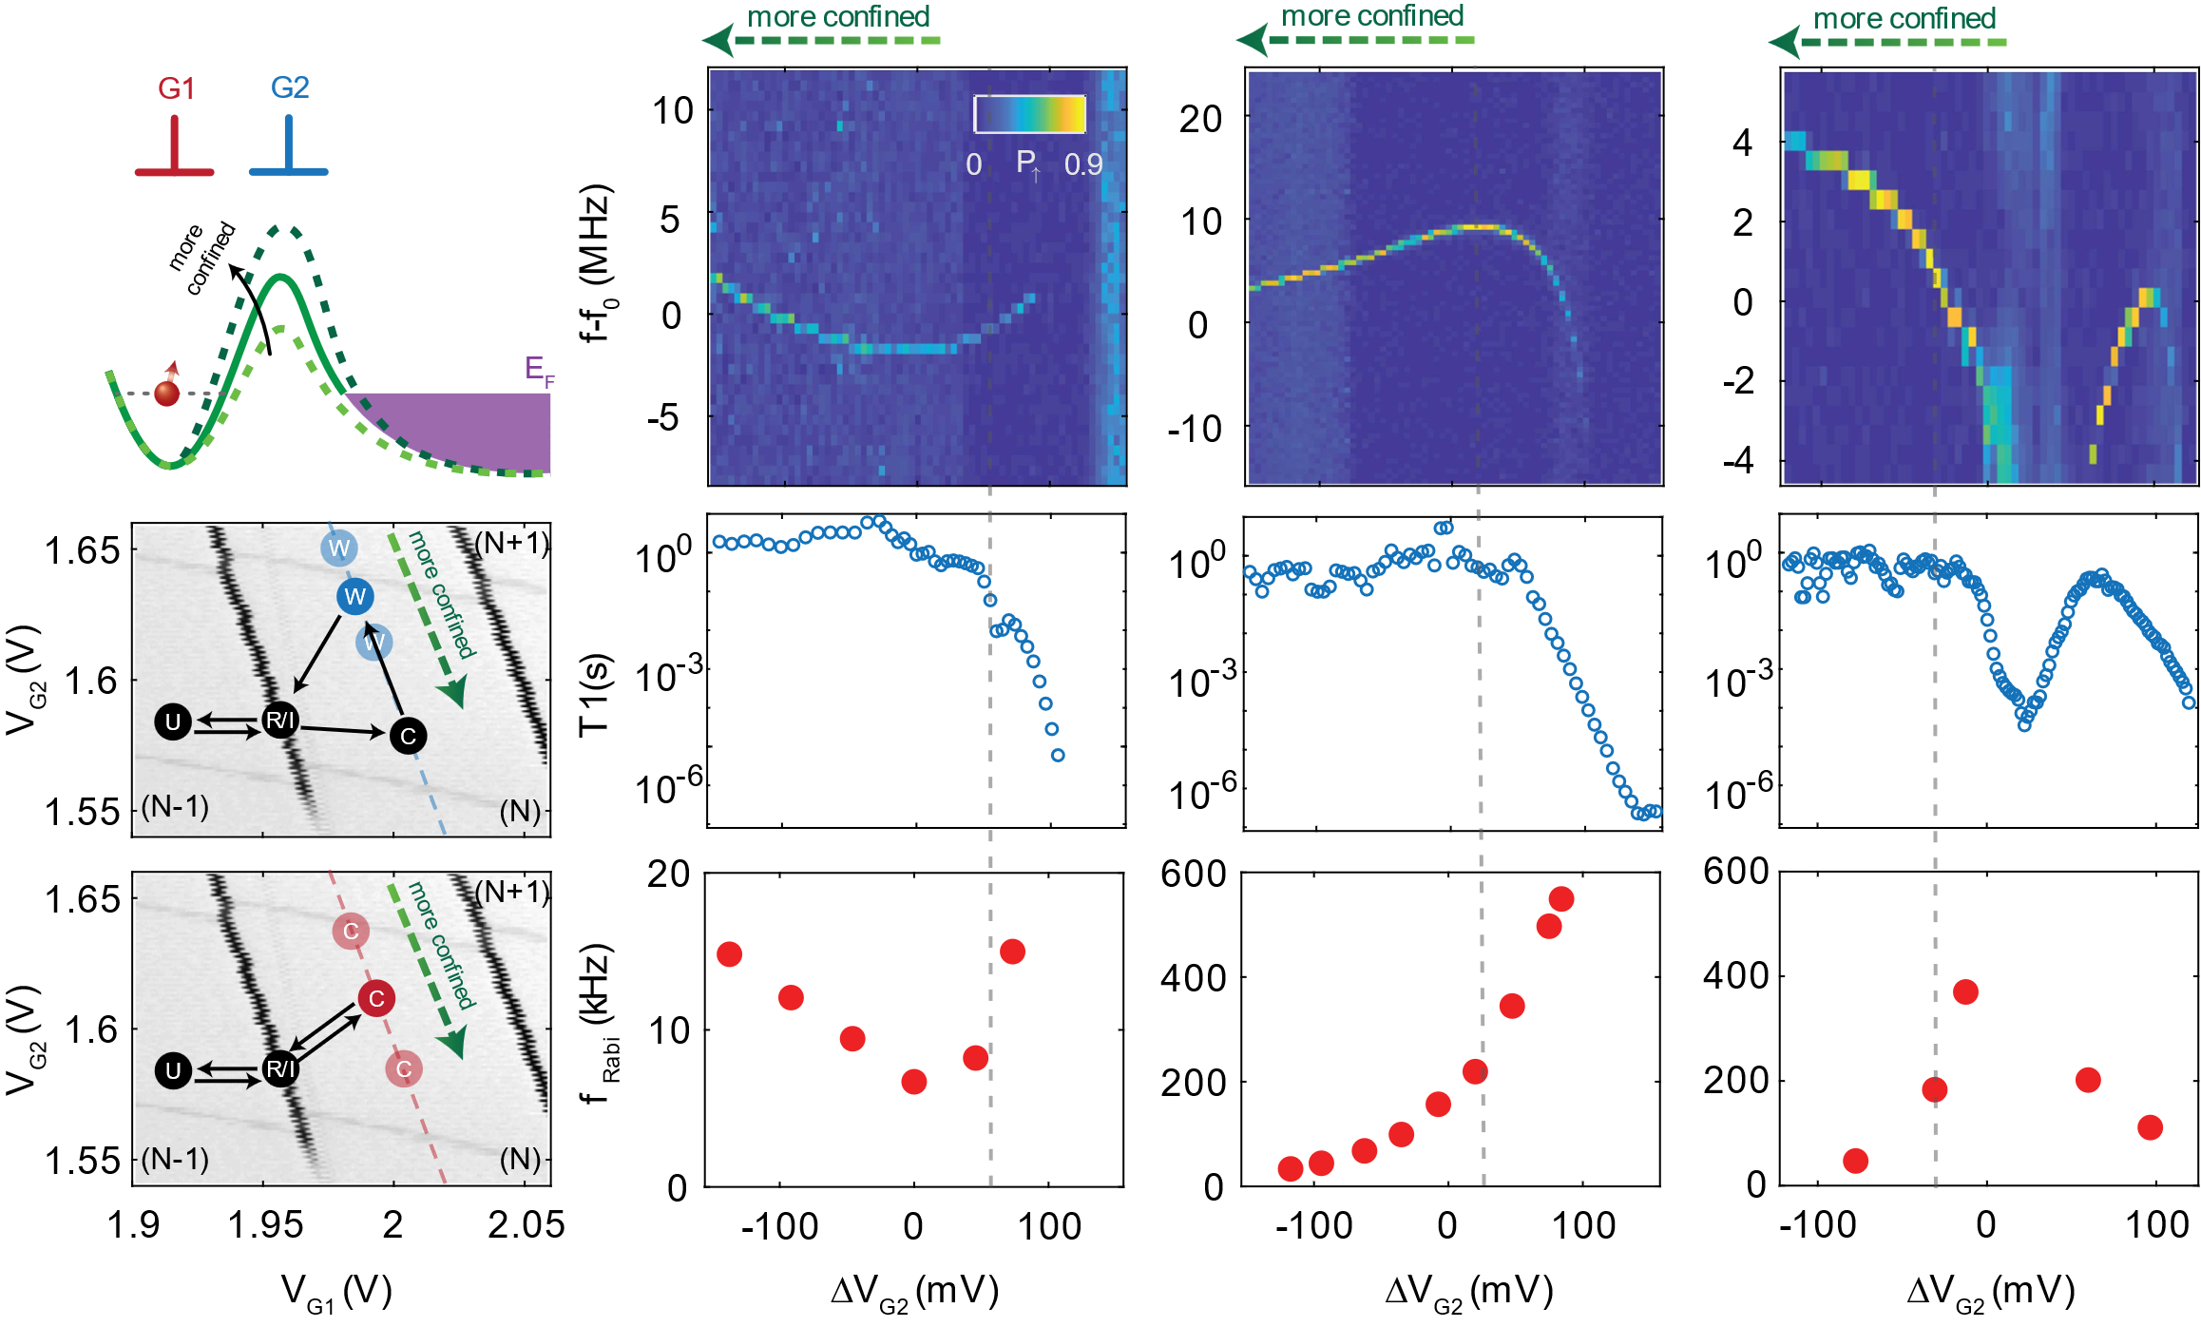
Suspicious speed-up
1 electron (s)
5 electrons (p)
13 electrons (d)
R.C.C. Leon et al., Nature Communications 7, 797 (2020)

Slide 9
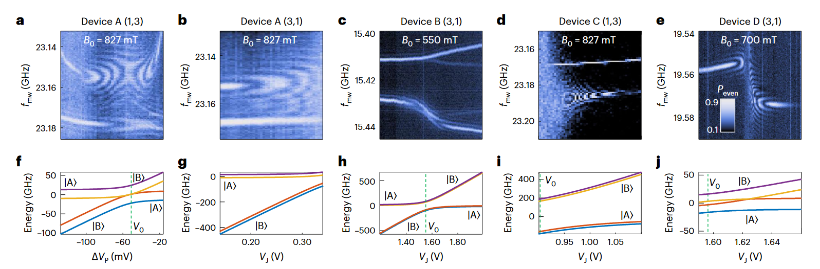
Electric driving: degeneracy
Will Gilbert et al., Nature Nanotechnology 18, 131–136 (2023)

Slide 10
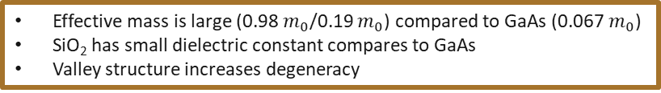
Argument for strong correlations
Effective mass is large (0.98 $m_{0}$/0.19 $m_{0}$) compared to GaAs (0.067 $m_{0}$)
SiO₂ has small dielectric constant compares to GaAs
Valley structure increases degeneracy

Slide 11
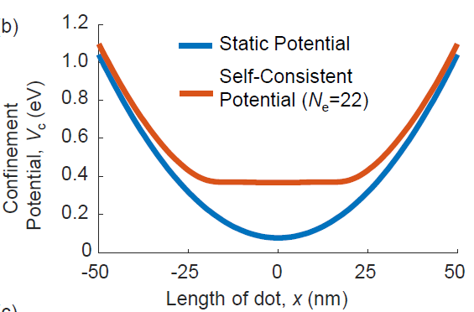
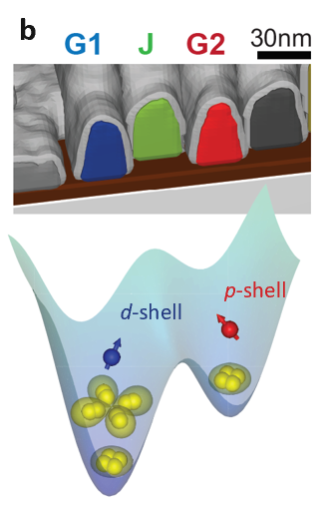
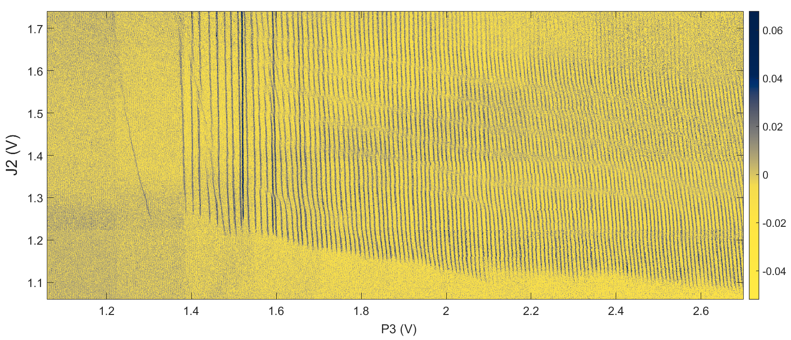
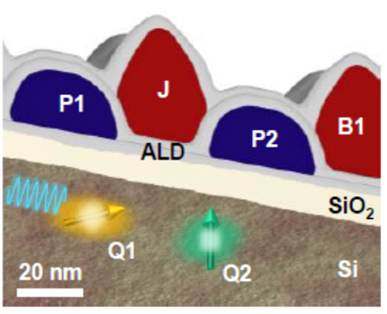

Argument for strong correlations
Effective mass is large (0.98 $m_{0}$/0.19 $m_{0}$) compared to GaAs (0.067 $m_{0}$)
SiO₂ has small dielectric constant compares to GaAs
Valley structure increases degeneracy
Maybe the size has an effect?
vs
vs
Jellybean – a very long dot (see MengKe Feng’s talk)
Genuine question: do smaller dots lead to more or less correlations?

Slide 12
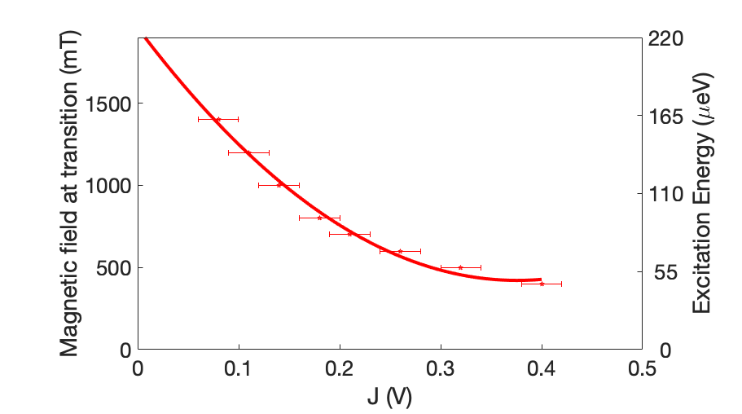
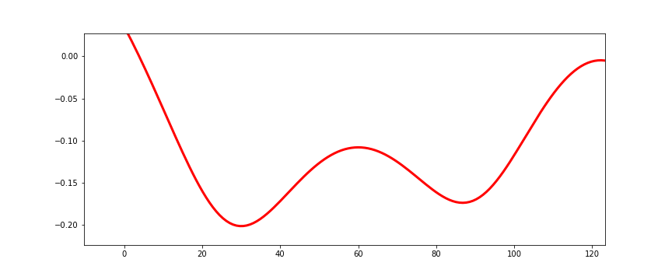





Lately: highly complex behaviour >50% of the time
Measured excitation energy, tracking degeneracy point vs Zeeman splitting
P4
J3
P3
(5,3) electronic configuration
Excited state in the 5-electron dot causes EDSR at high B field
Negative exchange when the excited state is nearby
800mT
500mT
86mT
800mT
500mT
86mT
Exchange
exchange control gate (V)
Negative Exchange?
Leaking to Excited State?
3e-
5e-
5e-
0
200
Excitation Energy$(μ\text{eV}\text{)}$
Lower B field
Unpublished

Slide 13





Mechanism for negative exchange
Mechanism for correlation-driven EDSR
Normal Exchange
Possible negative exchange mediated by excited state
t2
t

Slide 14

Why some dots display strong correlations and others don’t?
Seem to be present in dots large or small
Seem to be present even when the shell structure doesn’t imply degeneracy
Often it is controllable by side gates
Seems to have roots in dot elongation and/or dot anharmonicity
Dylan Liang et al, arXiv:2407.04289v1
(to appear in IEEE Nano)

Slide 15

Summary and open questions
Pros
Cons
Circumvents valley splitting
Gives a dot another opportunity for a qubit
Increases wavefunction, facilitating exchange coupling
Creates the means for EDSR if needed
Potentially screens electric noise (not proven)
Complicates variability
Adds T1 hotspots
Adds leakage (which is complicated for QEC)
Requires complicated tuning to leverage EDSR
Creates non-linear Stark shift (effects unclear)
We currently feel that pros > cons and use multielectron states in our daily operations
Open questions:
What is a good model of $ε(r)$?
Can we construct a good exchange/correlation potential?
Can we model valleys/spin orbit effect well?
What are good protocols to identify strongly correlated states phenomenologically?
How do we anticipate intuitively whether a dot will be dominated by correlations or not?

Slide 16







Benchmarks with FOUNDRY PARTNERS
We have demonstrated high fidelity (>99.9%) single-qubit operation on a
foundry device manufactured in a
300 mm line.
Dumoulin Stuyck, et al IEEE SNW 2024
Next 12 months at Diraq
GlobalFoundries quantum dots
More qubits, 2Q gates, denser connectivity

Slide 17




Andre Saraiva
Head of Solid-State Theory
Andre@diraq.com
Want to work with us? We’re hiring!
Send us an email: hr@diraq.com
Follow us for updates:
linkedin.com/company/diraq
@diraqQC

